Slide 1
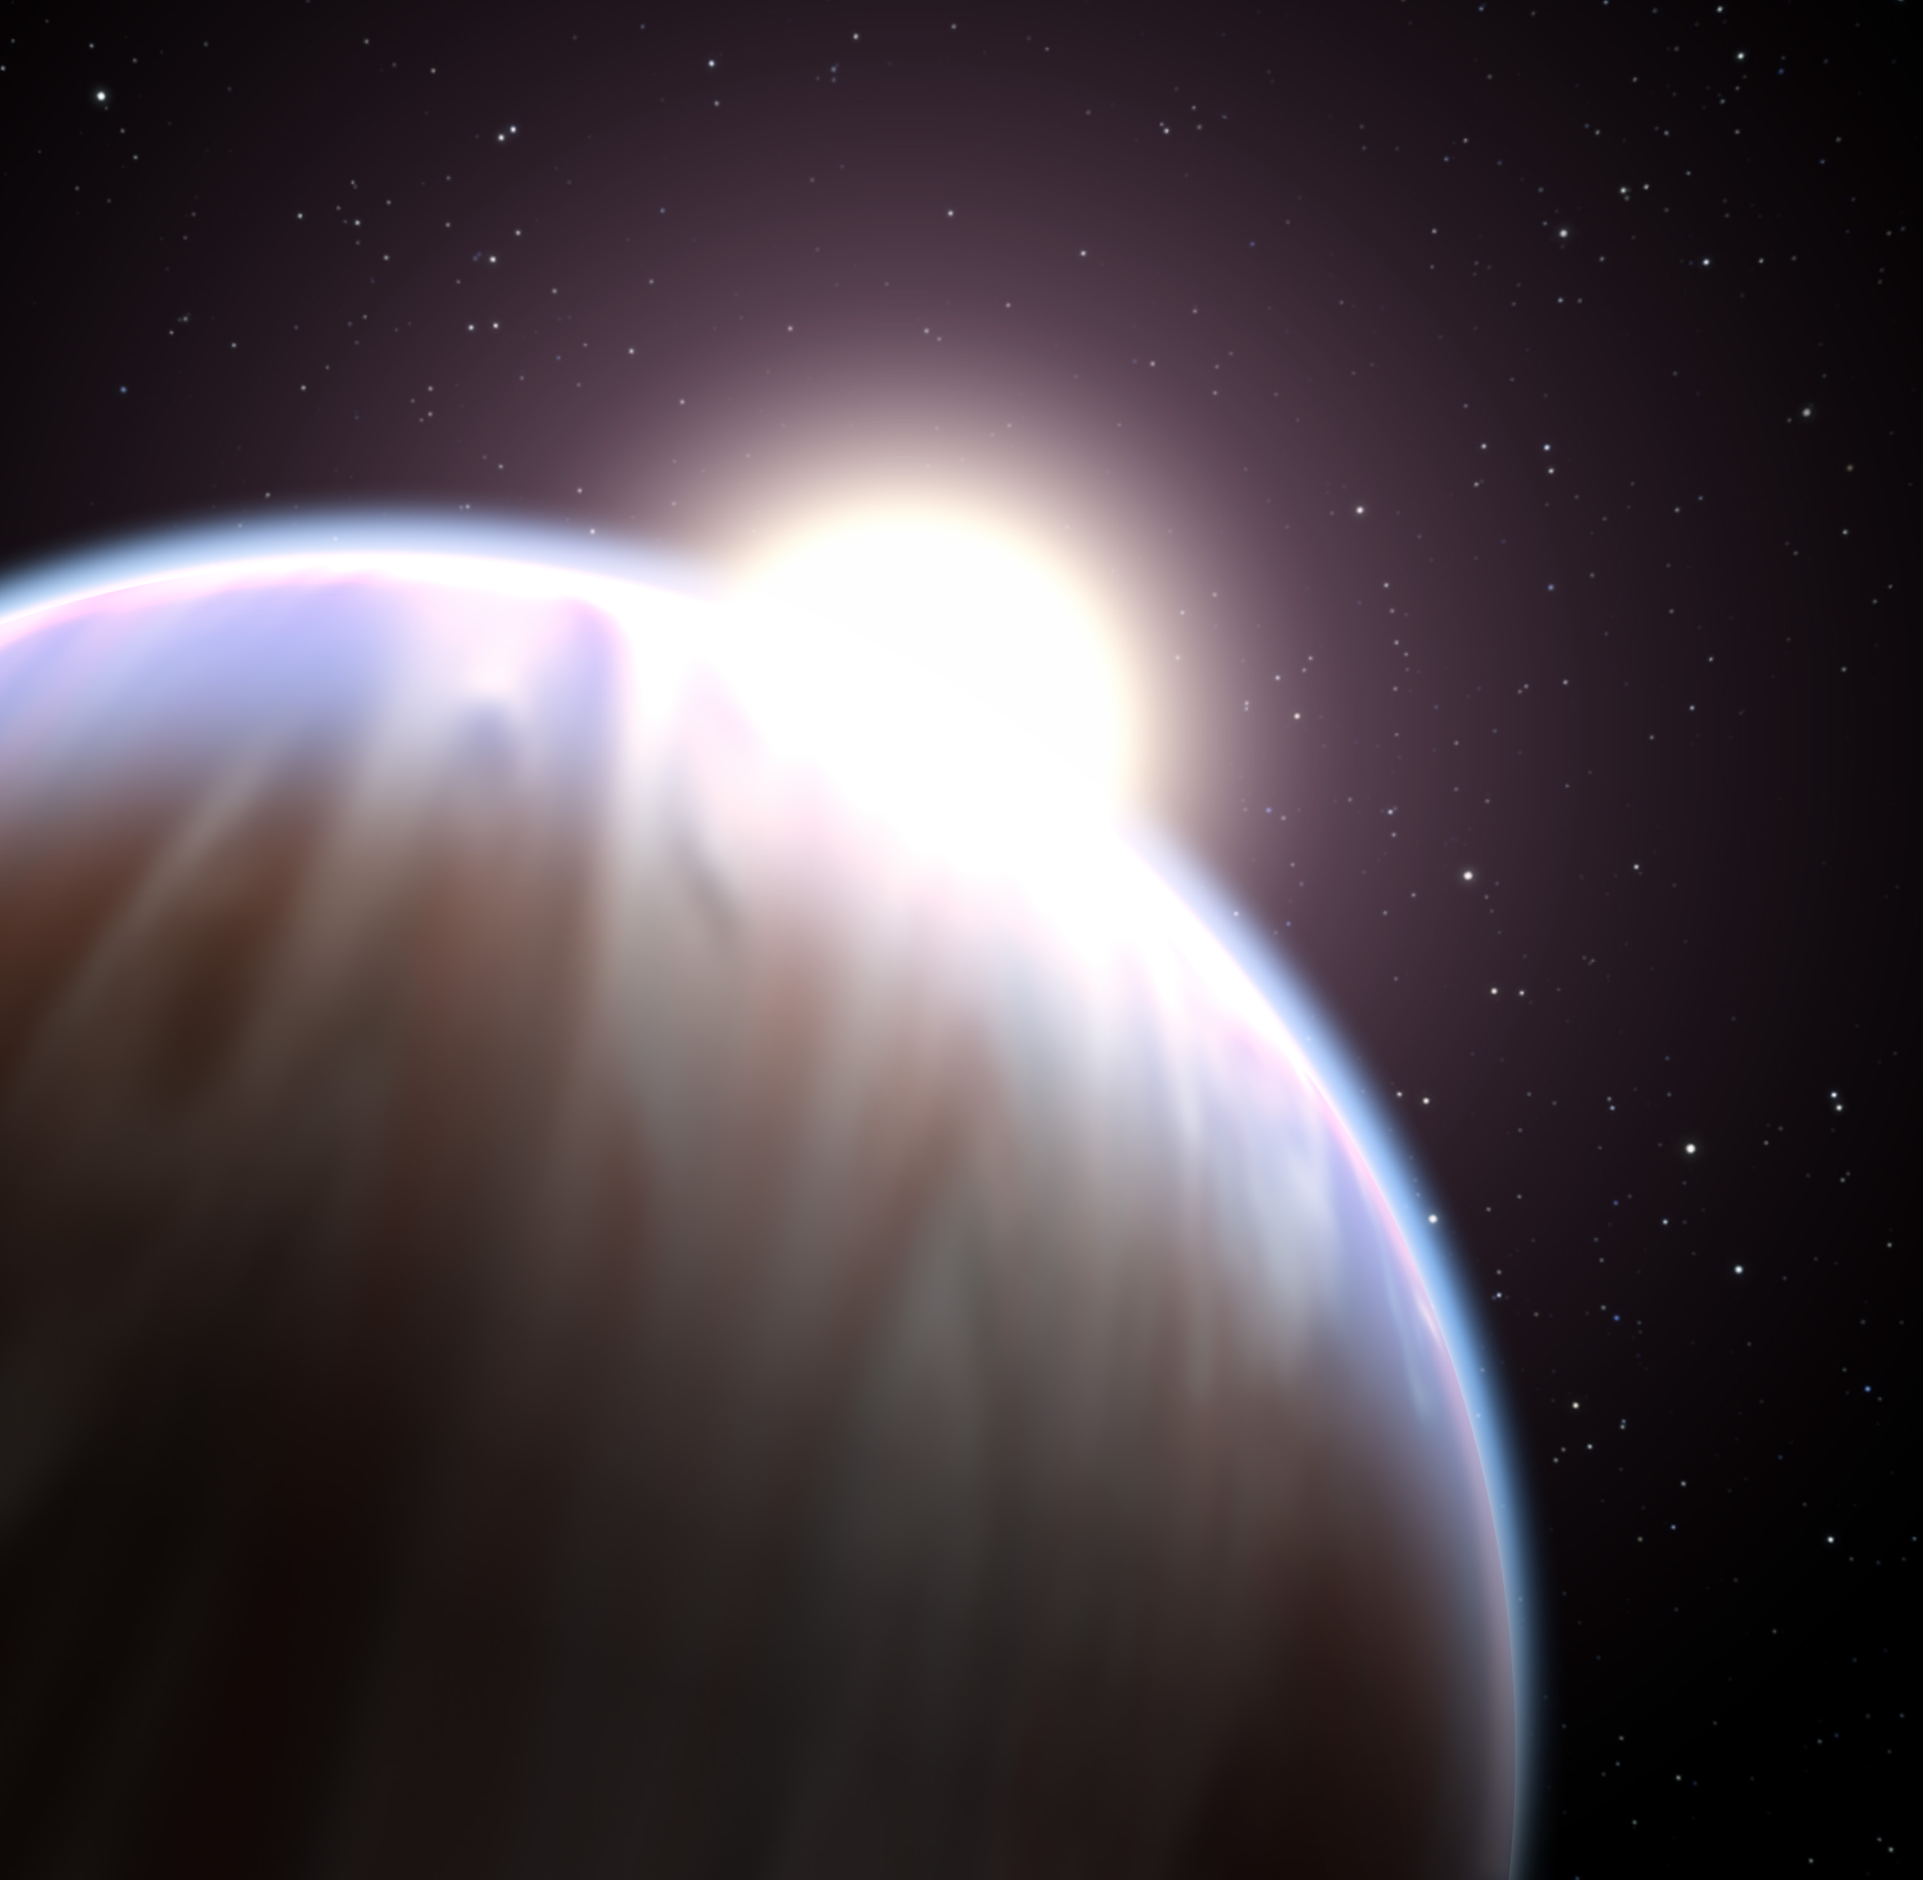


ATMOSPHERIC COMPOSITION BEYOND THE C/O RATIO
Néstor Espinoza
Pontificia Universidad Católica de Chile
Mentors: Jonathan Fortney & Yamila Miguel
CO-Is: K. Lodders & B. Fegley

Slide 3
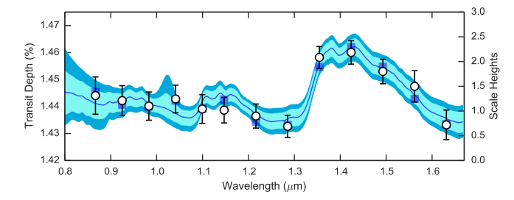
Kreidberg et al. (2015)

Slide 4
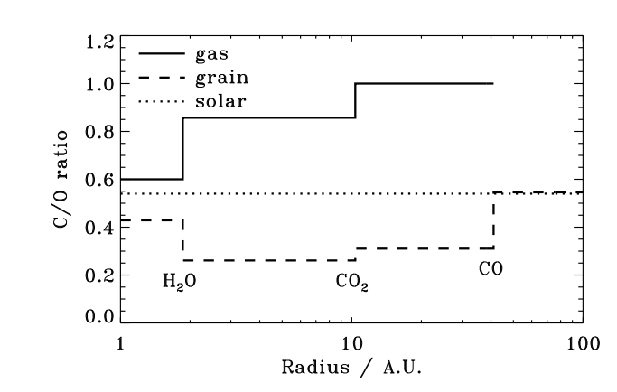
Öberg, Murray-Clay & Bergin (2011)

Slide 5
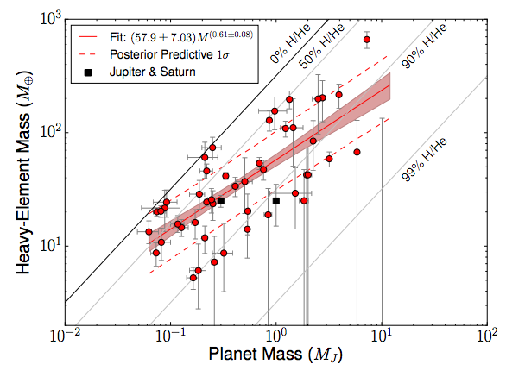
Thorngren et al. (2016)

Slide 6
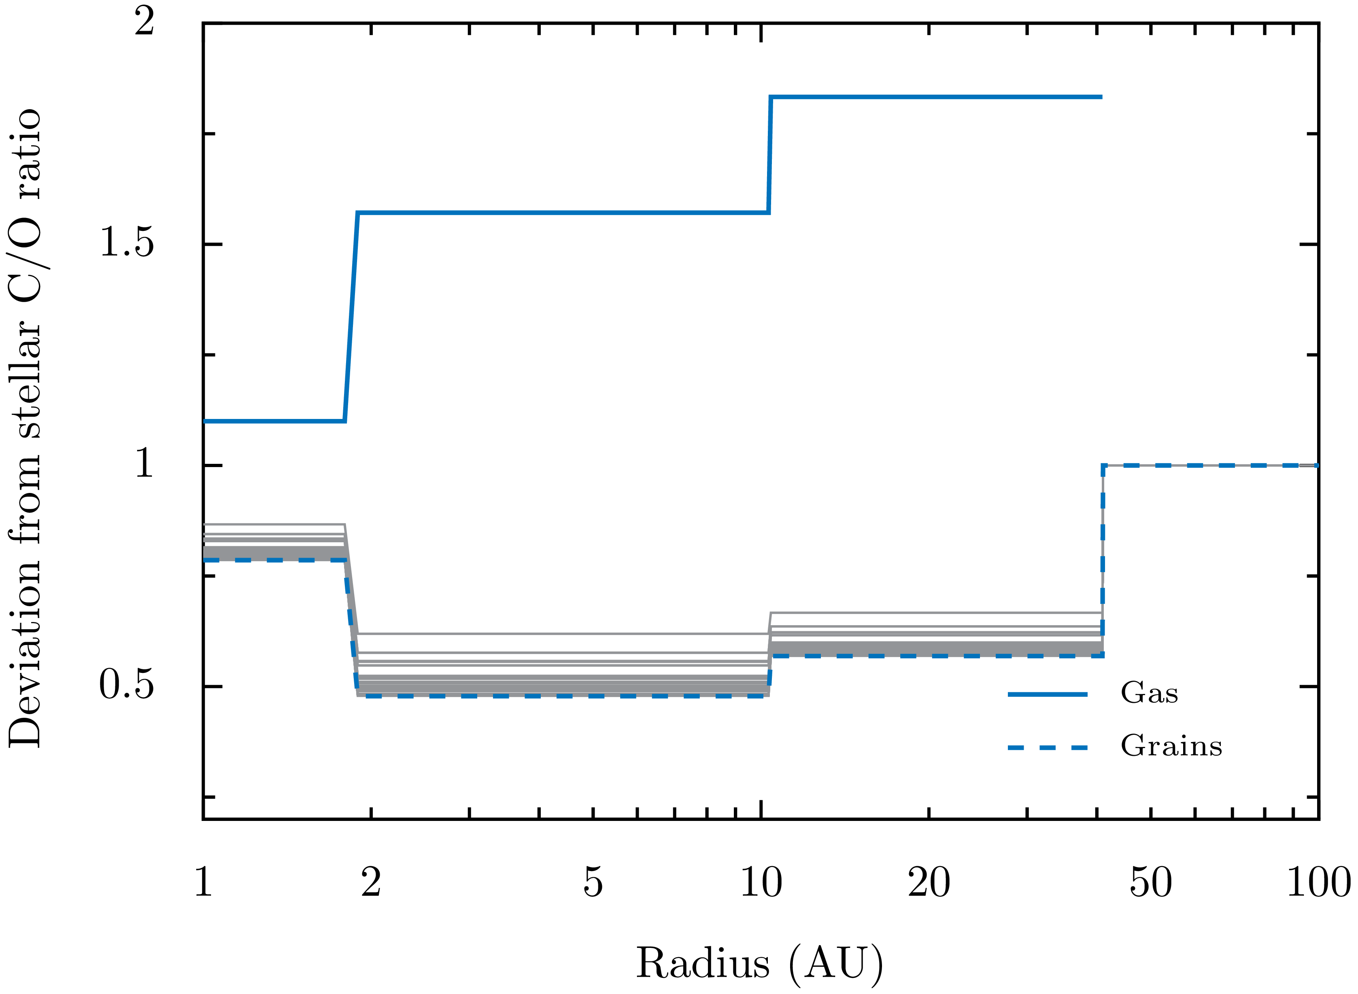
CO
H₂O
CO₂

Slide 7
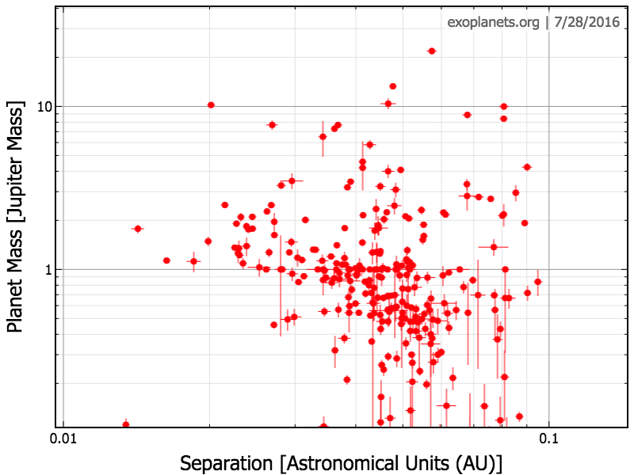

Slide 8
Beyond the C/O Ratio

Slide 9
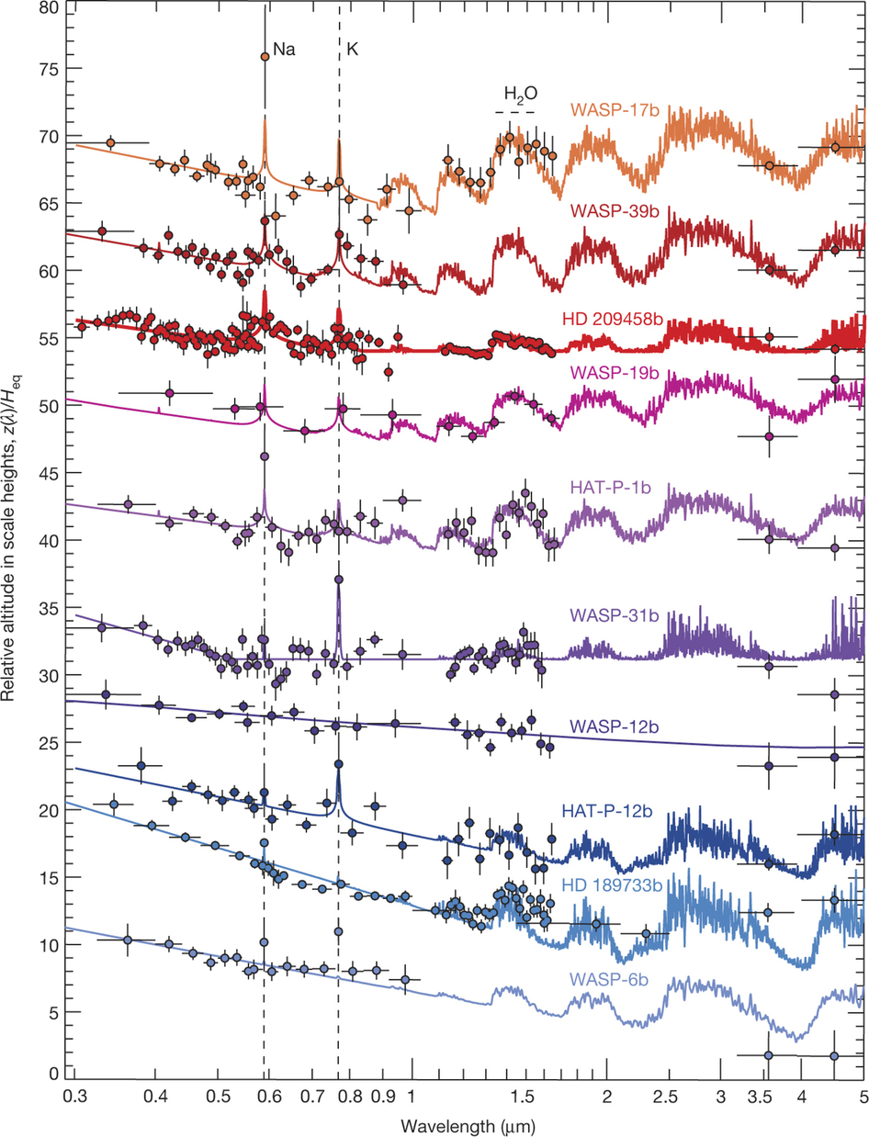
(Sing et al., 2016)

Slide 10
Our “big 6”:
Na, K, Ti, V, Fe, O
(Sing et al., 2016)

Slide 11
Our “big 6”:
Na, K, Ti, V, Fe, O
(Sing et al., 2016)

Slide 12
Our “big 6”:
Na, K, Ti, V, Fe, O
+ (time-evolving) physics
+ (time-evolving) chemistry
(Sing et al., 2016)

Slide 13
THE MODEL
1+1D Chambers (2009) disk model.

Slide 14
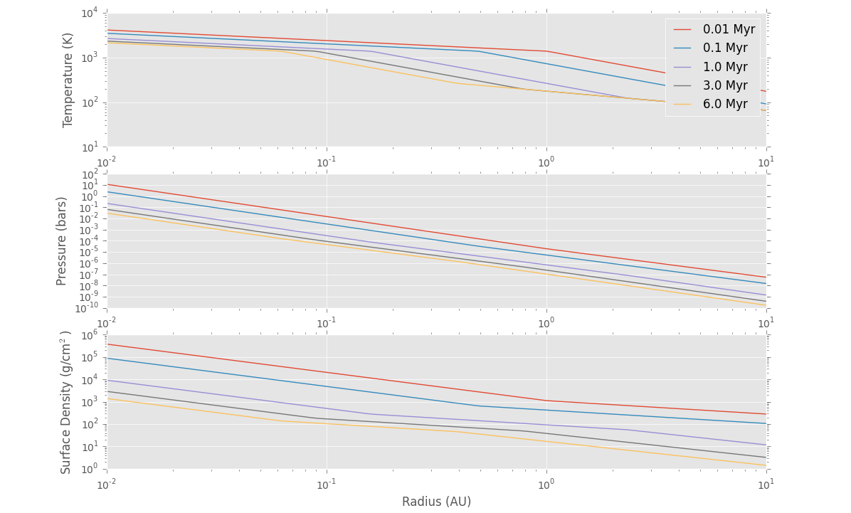
THE MODEL
1+1D Chambers (2009) disk model.

Slide 15
THE MODEL
1+1D Chambers (2009) disk model.
Chemical equilibrium (w/ CEA).

Slide 16
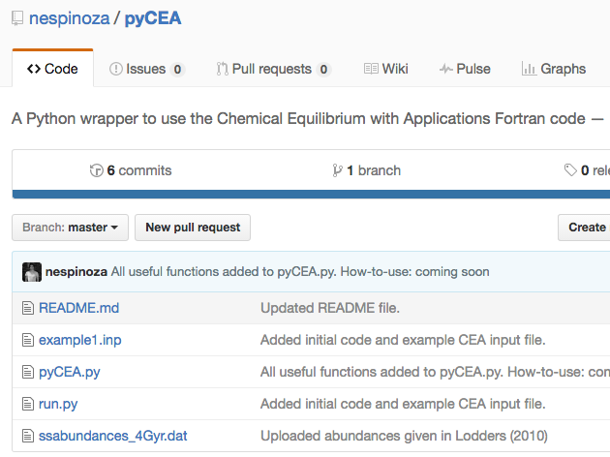
THE MODEL
1+1D Chambers (2009) disk model.
Chemical equilibrium (w/ CEA).
(github.com/nespinoza/pyCEA)

Slide 17
THE MODEL
Chemical network
Lodders et al. (2003)
Moriarty et al. (2014)

Slide 18
THE MODEL
Chemical network
Lodders et al. (2003)
Moriarty et al. (2014)
Gas species: Al AlN AlC AlH AlH₂ ALO ALOH ALS
C CH₄ CN CO CO₂ CS
Ca CaH CaO CaOH CaS
K KCN KH KOH
Fe FeH FeO FeS Fe(OH)₂
H H₂ H₂O H₂S HCN HCO HS
He
Mg MgH MgN MgO MgOH MgS
Solid species:
NaAlSi₃O₈
KAlSi₃O₈
MgAl₂O₄
Al₂O₃
Ca₂Al₂SiO₇
N N₂ NH NH₃ NO
Na Na₂ NaH NaO NaOH
O O₂ OH
S S₂ SN SO SO₂
Si SiH SiH₄ SiN SiO SiS
Ti TiO TiO₂ TiS
V VN VO VO₂
Mg₂SiO₄
Fe(a,c)
FeS(a,b,c)
CaAl₁₂O₁₉
CaAl₂Si₂O₈
Al
Fe(a,c)
FeS(a,b,c)
CaAl₁₂O₁₉
CaAl₂Si₂O₈
CaTiO₃
TiN
Ti₂O₃
V₂O₃
Fe₃O₄
MgS
MgSiO₃

Slide 19
THE MODEL
Chemical network
Lodders et al. (2003)
Moriarty et al. (2014)
Gas species: Al AlN AlC AlH AlH₂ ALO ALOH ALS
C CH₄ CN CO CO₂ CS
Ca CaH CaO CaOH CaS
K KCN KH KOH
Fe FeH FeO FeS Fe(OH)₂
H H₂ H₂O H₂S HCN HCO HS
He
Mg MgH MgN MgO MgOH MgS
Solid species:
NaAlSi₃O₈
KAlSi₃O₈
MgAl₂O₄
Al₂O₃
Ca₂Al₂SiO₇
N N₂ NH NH₃ NO
Na Na₂ NaH NaO NaOH
O O₂ OH
S S₂ SN SO SO₂
Si SiH SiH₄ SiN SiO SiS
Ti TiO TiO₂ TiS
V VN VO VO₂
Mg₂SiO₄
Fe(a,c)
FeS(a,b,c)
CaAl₁₂O₁₉
CaAl₂Si₂O₈
Al
Fe(a,c)
FeS(a,b,c)
CaAl₁₂O₁₉
CaAl₂Si₂O₈
CaTiO₃
TiN
Ti₂O₃
V₂O₃
Fe₃O₄
MgS
MgSiO₃

Slide 20
Results pt. I

Slide 21
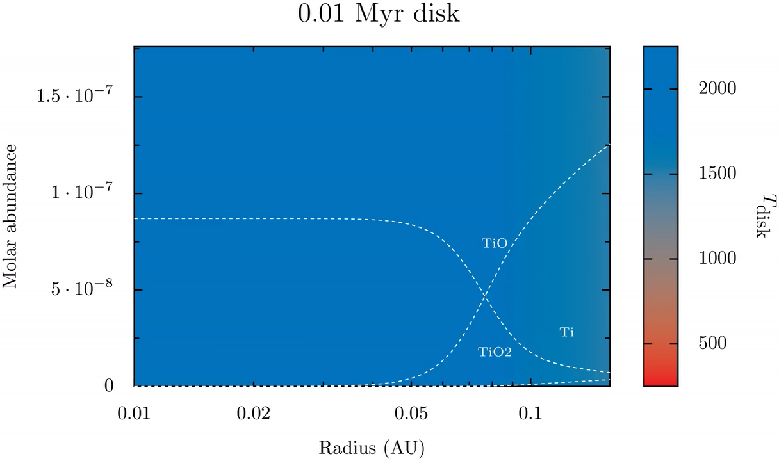
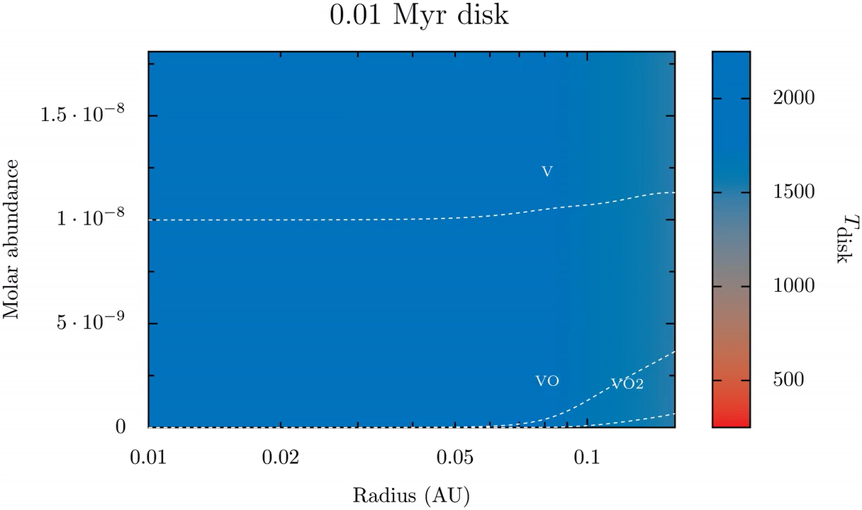
Molar fraction
Radius (AU)

Slide 22
Molar fraction
Radius (AU)

Slide 23
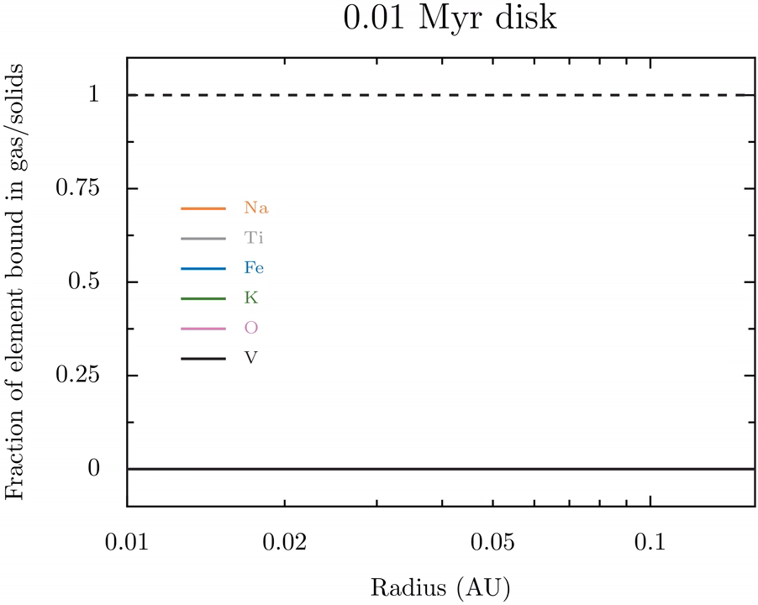

Slide 25
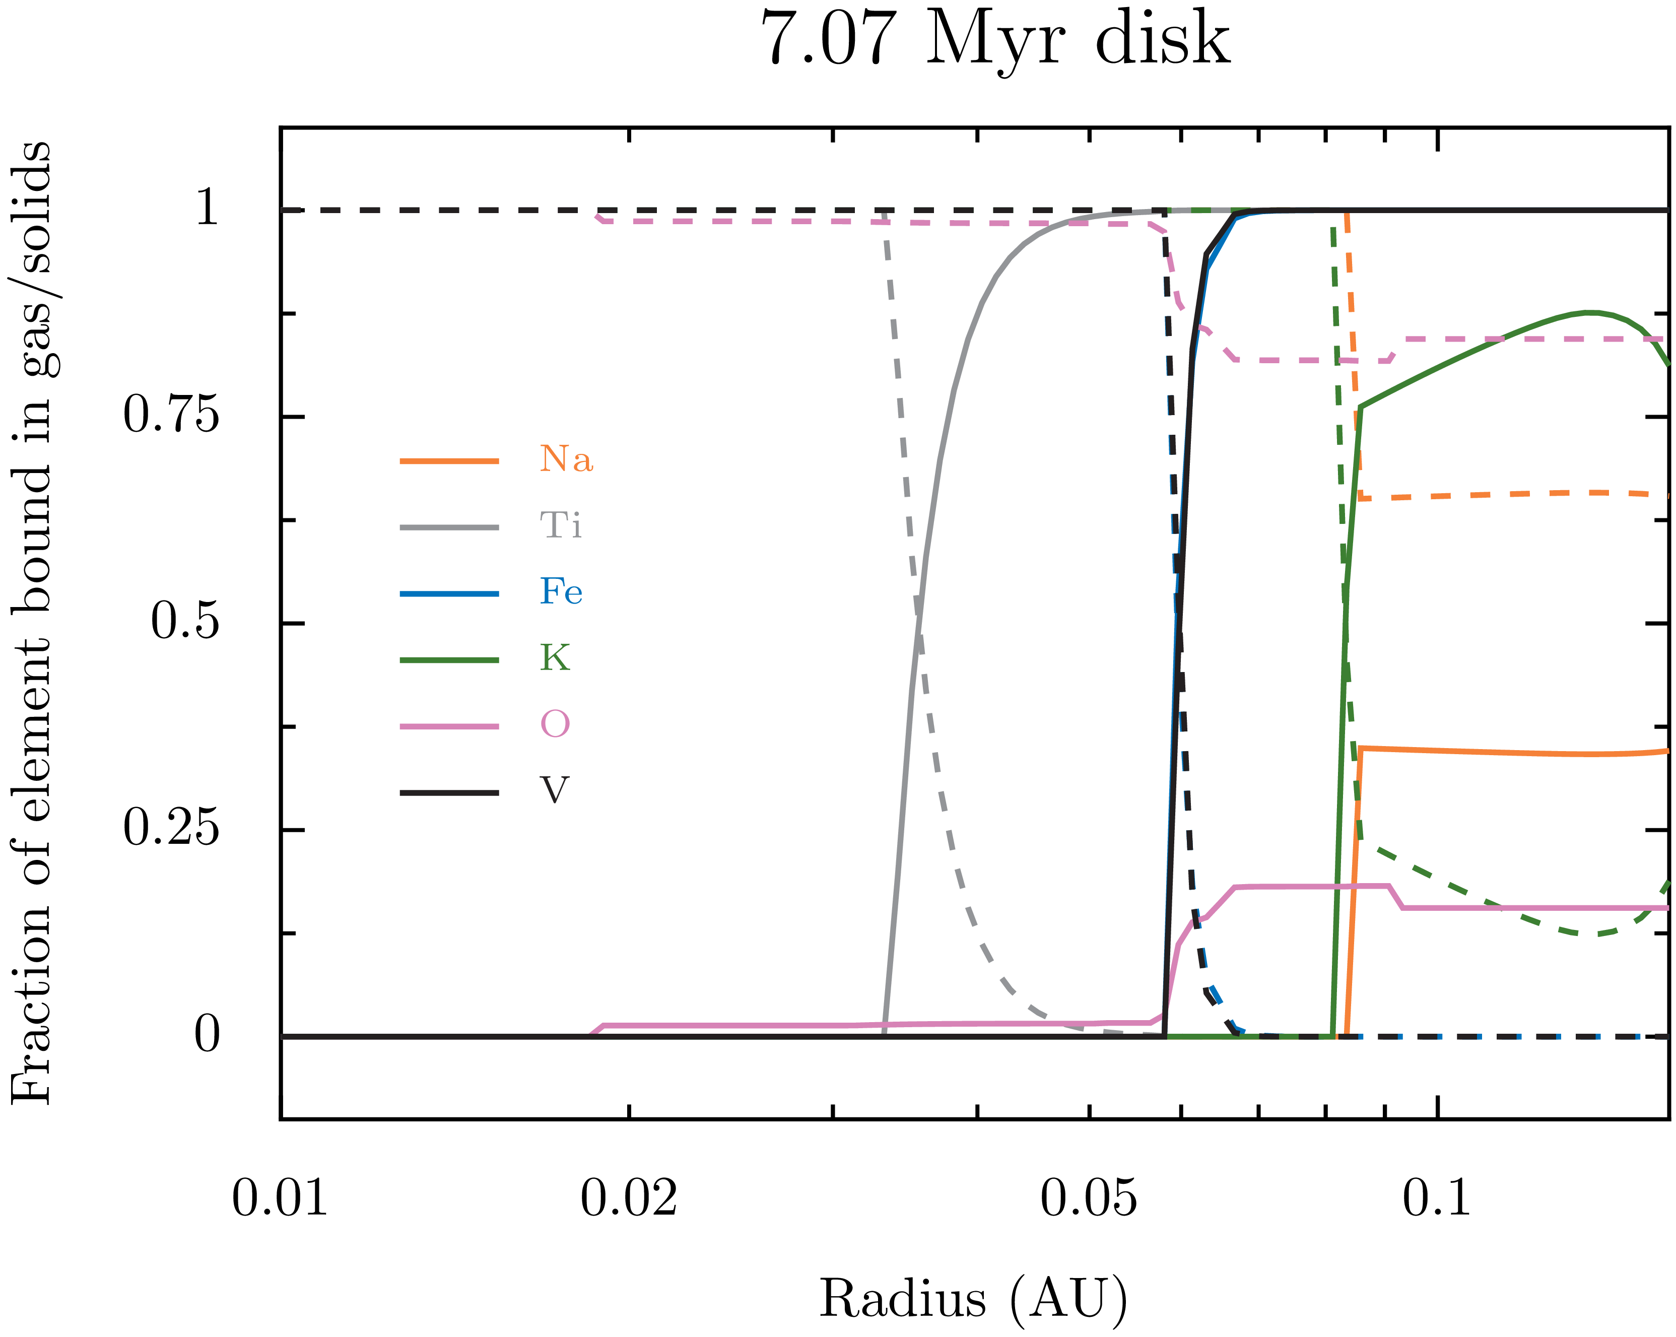

Slide 27

Results pt. II

Slide 28
TWO IN-SITU PLANETS

Slide 29
TWO IN-SITU PLANETS

Slide 30
TWO IN-SITU PLANETS

Slide 31
0.1 AU IN-SITU PLANET
Miguel & Brunini (2008, 2009, 2010)
Miguel et al. (2011a, 2011b)

Slide 32
0.1 AU IN-SITU PLANET
Miguel & Brunini (2008, 2009, 2010)
Miguel et al. (2011a, 2011b)
M_{envelope} = 0.6M_{Jup}
5.65M_{Earth}

Slide 33
0.1 AU IN-SITU PLANET
Miguel & Brunini (2008, 2009, 2010)
Miguel et al. (2011a, 2011b)

Slide 34
0.1 AU IN-SITU PLANET
Miguel & Brunini (2008, 2009, 2010)
Miguel et al. (2011a, 2011b)
M_{envelope} = 0.6M_{Jup}
M_{gas} = 188.7M_{Earth} M_{solids} = 5.3M_{Earth}
(Z=0.01) (Z=1)
5.65M_{Earth}

Slide 35
0.1 AU IN-SITU PLANET
Miguel & Brunini (2008, 2009, 2010)
Miguel et al. (2011a, 2011b)
M_{envelope} = 0.6M_{Jup}
Ratios dominated by
ratios in solids!
M_{solids} = 5.3M_{Earth}
M_{gas} = 188.7M_{Earth} M_{solids} = 5.3M_{Earth}
(Z=0.01) (Z=1)
5.65M_{Earth}

Slide 36
0.1 AU IN-SITU PLANET
Miguel & Brunini (2008, 2009, 2010)
Miguel et al. (2011a, 2011b)

Slide 37
0.1 AU IN-SITU PLANET
Miguel & Brunini (2008, 2009, 2010)
Miguel et al. (2011a, 2011b)
M_{core} = 5.65M_{Earth} M_{envelope} = 0.6M_{Jup}
X_{env} = 0.69 Y_{env} = 0.27 Z_{env} = 0.04 (3x solar)

Slide 38
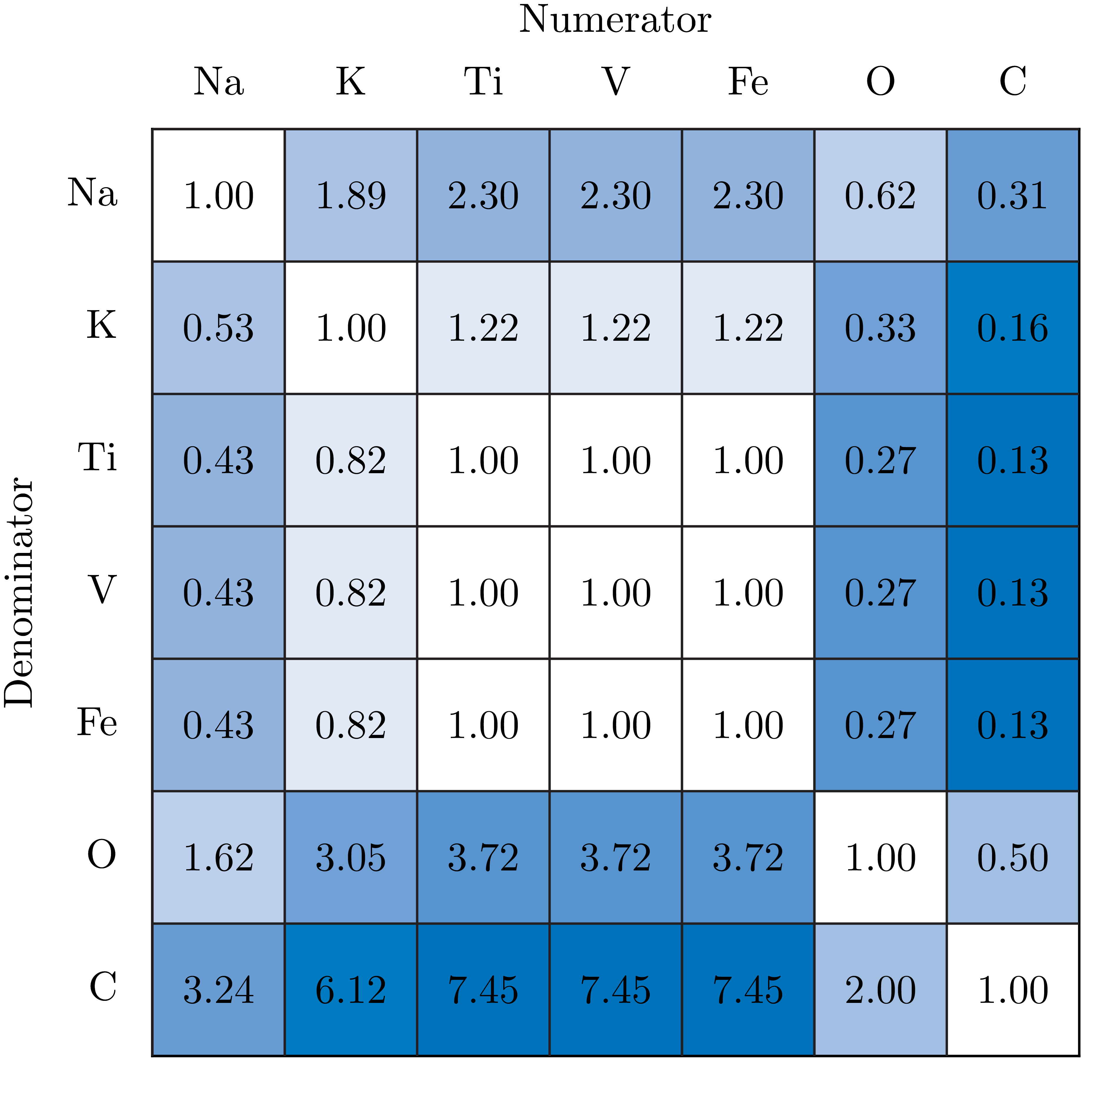
0.1 AU IN-SITU PLANET
Miguel & Brunini (2008, 2009, 2010)
Miguel et al. (2011a, 2011b)
M_{core} = 5.65M_{Earth} M_{envelope} = 0.6M_{Jup}
X_{env} = 0.69 Y_{env} = 0.27 Z_{env} = 0.04 (3x solar)

Slide 39
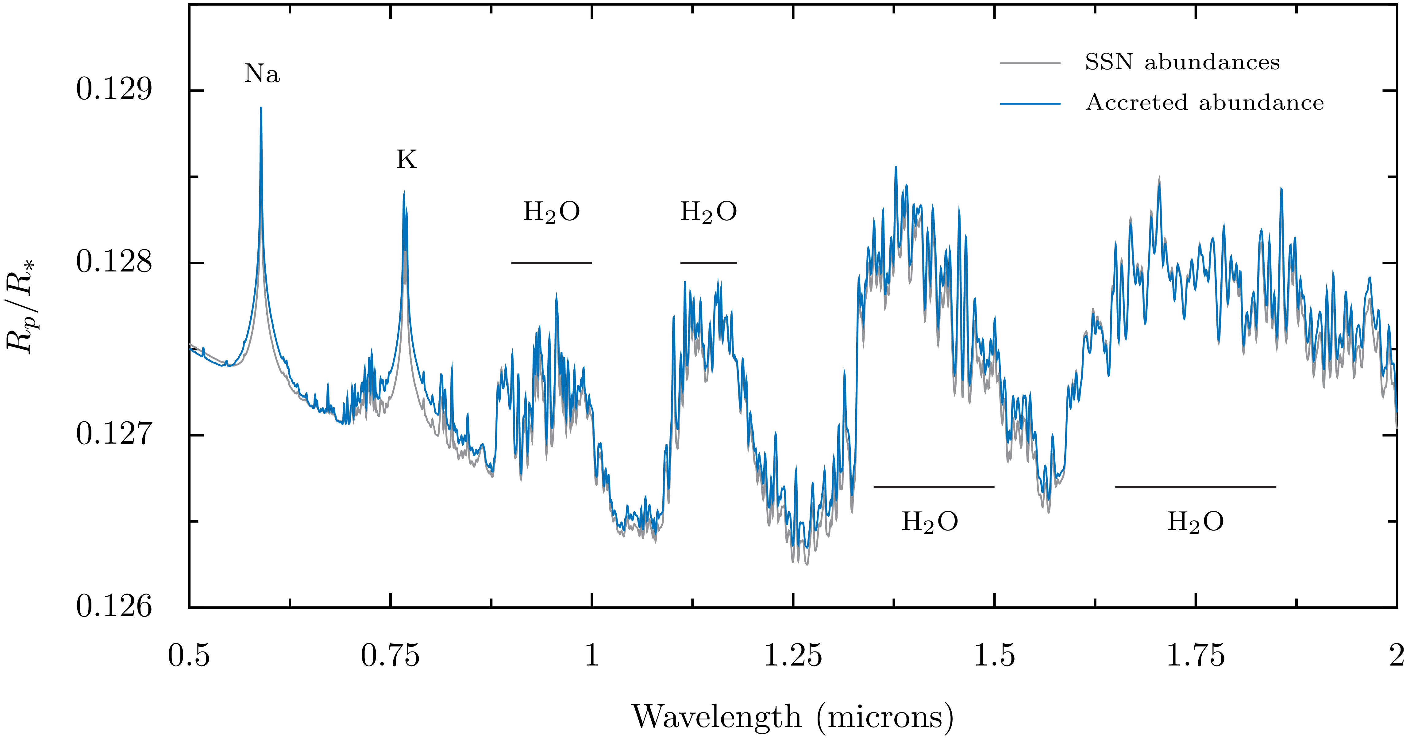
0.1 AU IN-SITU PLANET
Miguel & Brunini (2008, 2009, 2010)
Miguel et al. (2011a, 2011b)

Slide 40
0.1 AU IN-SITU PLANET
Miguel & Brunini (2008, 2009, 2010)
Miguel et al. (2011a, 2011b)
50 ppm!

Slide 41
0.05 AU IN-SITU PLANET
Miguel & Brunini (2008, 2009, 2010)
Miguel et al. (2011a, 2011b)

Slide 42
0.05 AU IN-SITU PLANET
Miguel & Brunini (2008, 2009, 2010)
Miguel et al. (2011a, 2011b)

Slide 43
0.05 AU IN-SITU PLANET
Miguel & Brunini (2008, 2009, 2010)
Miguel et al. (2011a, 2011b)
M_{core} = 4.57M_{Earth} M_{envelope} = 1.75M_{Jup}
X_{env} = 0.71 Y_{env} = 0.27 Z_{env} = 0.02 (1.4x solar)

Slide 44
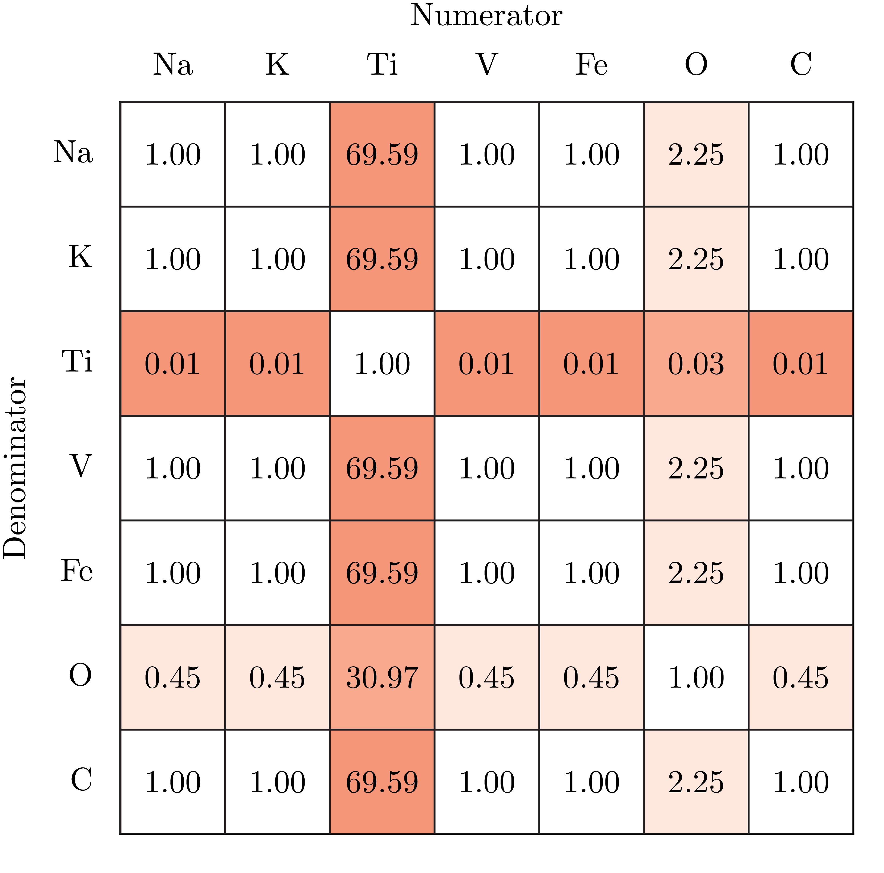
0.05 AU IN-SITU PLANET
Miguel & Brunini (2008, 2009, 2010)
Miguel et al. (2011a, 2011b)
M_{core} = 4.57M_{Earth} M_{envelope} = 1.75M_{Jup}
X_{env} = 0.71 Y_{env} = 0.27 Z_{env} = 0.02 (1.4x solar)

Slide 45
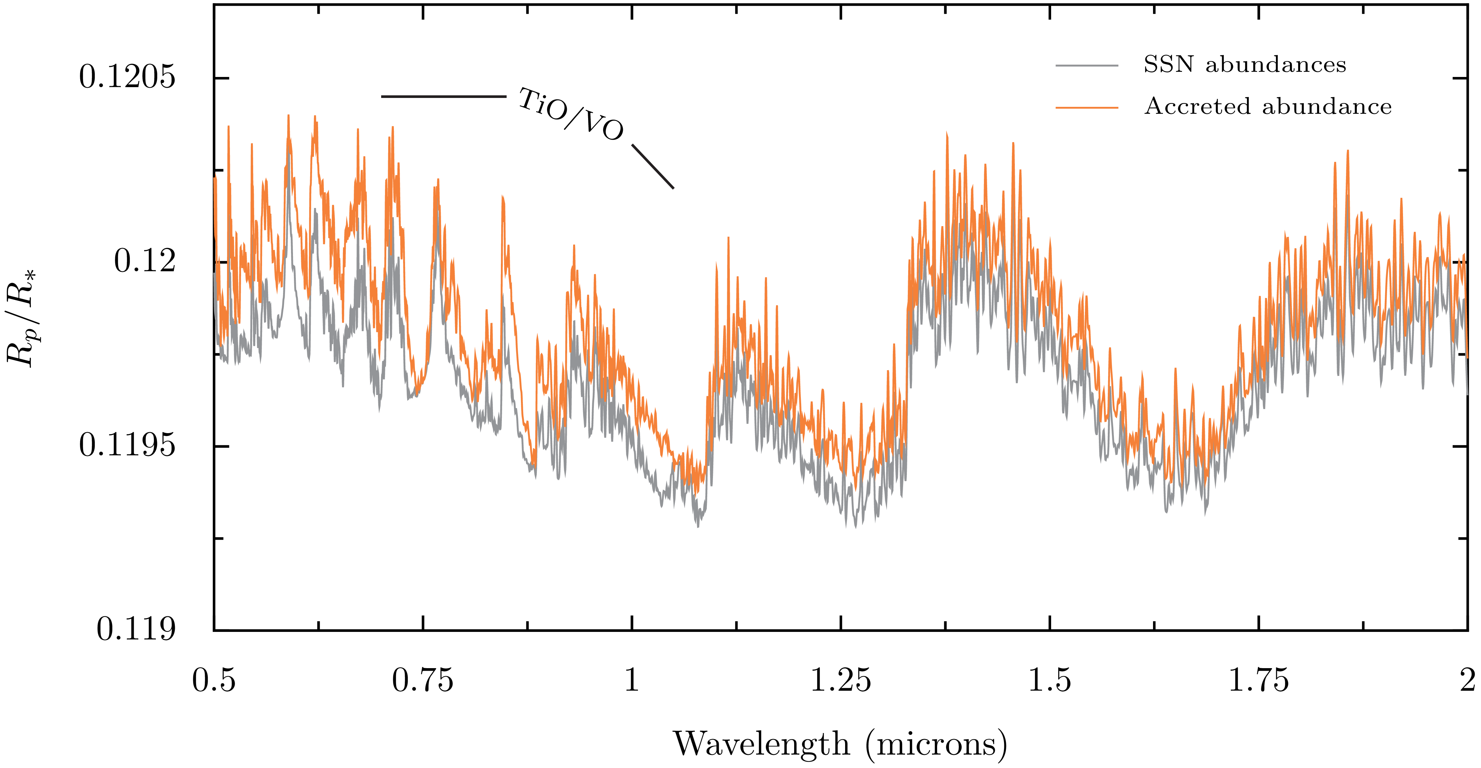
0.05 AU IN-SITU PLANET
Miguel & Brunini (2008, 2009, 2010)
Miguel et al. (2011a, 2011b)

Slide 46
0.05 AU IN-SITU PLANET
Miguel & Brunini (2008, 2009, 2010)
Miguel et al. (2011a, 2011b)
60 ppm!

Slide 47
Conclusions
Looking for elemental ratios? Follow the solids!

Slide 48
Conclusions
Looking for elemental ratios? Follow the solids!
If atmospheric accretion occurs in-situ, this leaves signatures on our “big 6” (Na, K, Fe, Ti, V, O). C/O ratios generally sub-stellar in our model.

Slide 49
Conclusions
Looking for elemental ratios? Follow the solids!
If atmospheric accretion occurs in-situ, this leaves signatures on our “big 6” (Na, K, Fe, Ti, V, O). C/O ratios generally sub-stellar in our model.
These imprint signatures that might be observable in the near future via transmission.

Slide 50
THANKS!

Slide 51
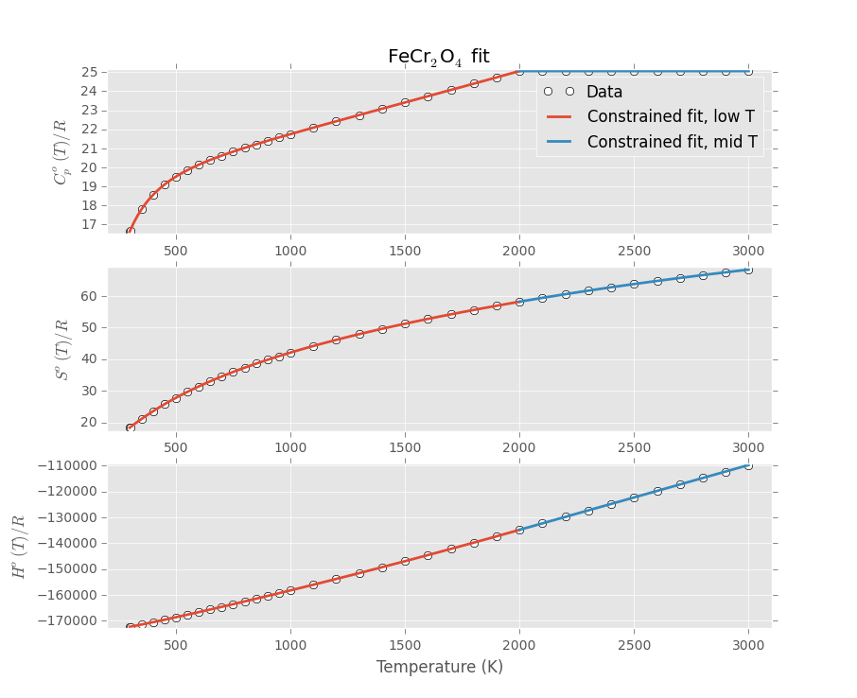
BACKUP 1: Condensates
+ dS = CdT/T
+ dH = CdT
+ Gibbs

Slide 52
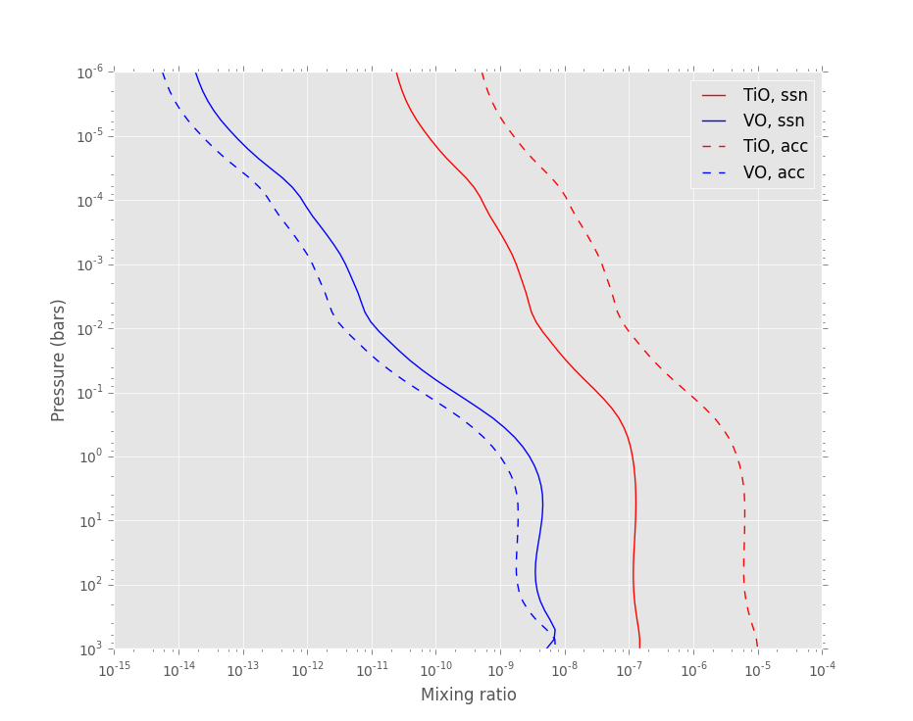
BACKUP 2: Mixing ratios pt. I

Slide 53
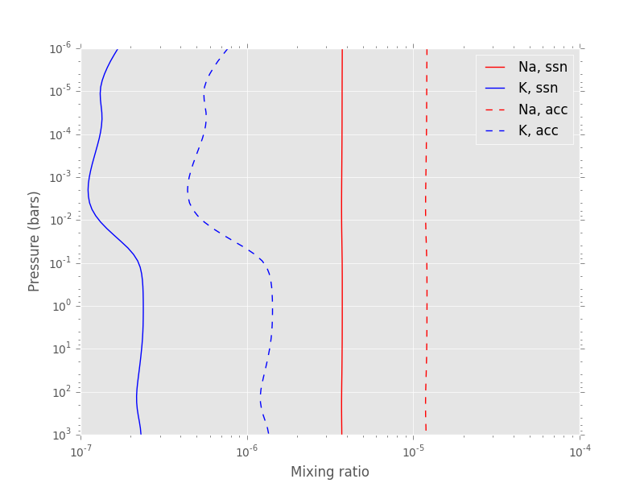
BACKUP 2: Mixing ratios pt. II

